Slide 1
CSE 518A Human-in-the-Loop Computation
Instructor: Chien-Ju Ho

Slide 2
Course Information
Announcements and discussion
Website: http://chienjuho.com/courses/cse518a
Piazza: http://piazza.com/wustl/fall2020/cse518a
Please check the website and Piazza regularly.
Time and location
Tue/Thu 4:00-5:20pm
Jubel 121 or Zoom (Access Zoom links via Canvas)
Questions?
Ask on Slido https://www.sli.do (#53093)
Unmute yourself and ask

Slide 3
Plan for today
Welcome and introduction
What’s the class about?
Logistics

Slide 4
About Me
Joined WashU in Fall 2017.
Research interests:
Design and analysis of human-in-the-loop systems
Crowdsourcing and human computation, machine learning, game theory, optimization, online behavioral social science, and human-computer interactions.

Slide 5
Human-in-the-Loop Computation?

Slide 6

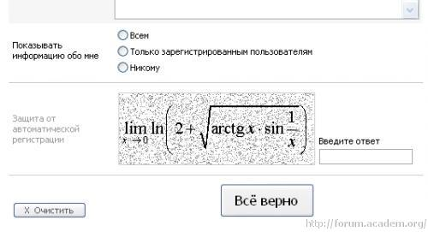
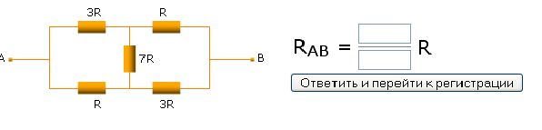
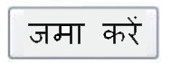
CAPTCHA
Completely Automated Public Turing test to tell Computers and Humans Apart
Humans
V4XBG
Bots
?????
A

Slide 7
Roughly 200 million CAPTCHAs are typed every day*
10s of human time per CAPTCHA
Can we utilize this wasted human computation power?
*statistics around 2011

Slide 8
What tasks are humans solving in CAPTCHAs?
Optical Character Recognition (OCR)
Hard for AI (at the time)
(Relatively) Easy for humans
Can we utilize CAPTCHAs to help solve OCR tasks?

Slide 9

Word 1: an OCR task to solve Word 2: tell apart humans and bots
“reCAPTCHA has completely digitized the archives of The New York Times and books from Google Books, as of 2011”
von Ahn et al. reCaptcha: Human-based Character Recognition via Web Security Measures. Science, September 2008

Slide 10
More than OCR
Google acquired reCAPTCHA in 2009.

Slide 12
The lawsuit was tossed by the judge. But ethical considerations (e.g., fairness, privacy) are important issues to consider in human-in-the-loop computation.

Slide 13
Are there other examples of human-in-the-loop computation?

Slide 15

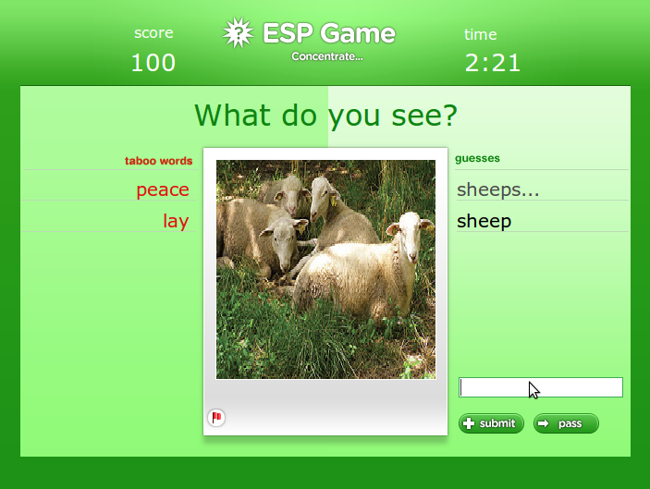
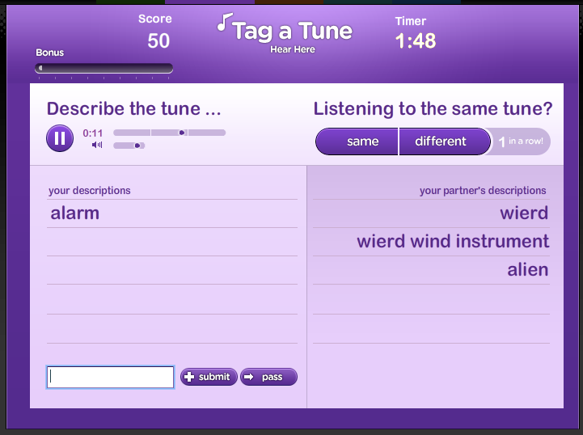
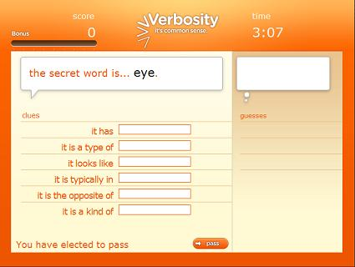
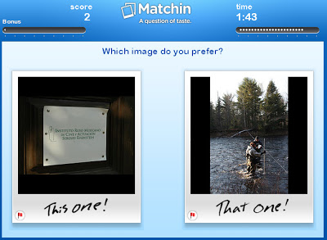


von Ahn and Dabbish. “Labeling Images with a Computer Game”. 2004.

Slide 16
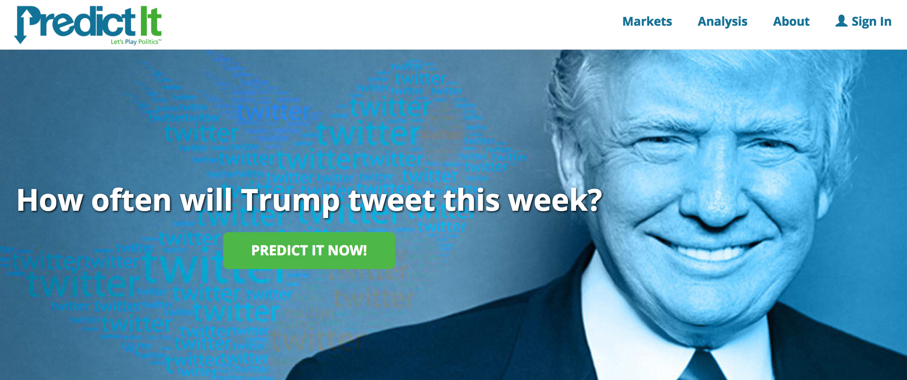
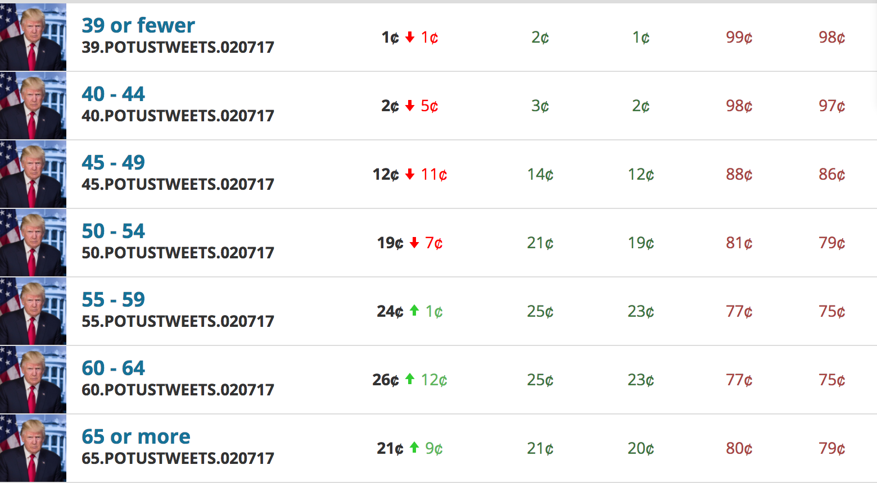

Slide 17
Education

Slide 18

















In fact, a lot more…

Slide 19

General-Purpose Platform: Crowdsourcing Markets
Post Tasks:
Specify payments
Audio transcription
Image tagging
Relevance evaluation
Handwriting recognition
Product information collection

Slide 20
What is this course about?
Study the design and analysis of human-in-the-loop computation.
Will cover research papers from a wide spectrum of research fields, including machine learning, economics, optimization, and human-computer interactions.
Human as data sources:
Label aggregation
Probabilistic reasoning to aggregate noisy human data
Practical challenges:
Complex tasks and teams
Studies on workflow and team designs from HCI perspective
Humans are “Humans”:
Incentive design
Game theoretical modeling of humans and incentive design
Selected recent topics:
Ethical issues of AI/ML, learning with strategic behavior, Human-AI collaborations.

Slide 21
Let’s take a look at the course schedule
http://chienjuho.com/courses/cse518a

Slide 22
Logistics

Slide 23
Grading
Course Project: 40%
Homework assignment: 20%
3~4 homework assignments
Paper reviews and class participation: 20%
Paper presentation and leading of discussion: 20%

Slide 24
Course Project
The main component of the course.
Could be an original research project or an extensive literature survey.
You are encouraged to start with a research project. You will have the chance to convert the project to literature review if things don’t go well.
Tentatively, you should work in groups of 2 (or 3 if the class size is large).
Will announce the detailed guidelines next week after the class size is finalized.

Slide 25
Tentative Timeline of Project
Oct 9: Project proposal (and deciding team members)
Brief description of the proposed project (1~2 paragraph)
Citing at least one paper that’s relevant to your proposal
Oct 30: Milestone 1
A brief literature review and the description of your plan (one page)
Last chance to change the topic of the project
Nov 20: Milestone 2
Summary of your current progress (up to 2 pages)
Last chance to convert the research project to (a more extensive) literature review
Dec 15/17: In-class project presentations
Dec 20: Project report due

Slide 26
Paper Reviews and Class Participation
Before each lecture, finish the required reading and submit a review (including a summary and answers to additional questions).
Due by the midnight before each lecture.
Exception: the review for next lecture is due at 2pm the day of the lecture.
It is important to come to the class for participate in discussion.
Participations will be part of your final grades

Slide 27
More on the Required Reading…
You are not expected to understand every detail or every proof in the papers that we cover.
However, you should be ready to answer the following questions:
Summary the paper in 2~3 sentences.
What’s the research question the paper is solving?
What’s the proposed approach?
What are the results?
Illustrate what you like/dislike about the paper.
Discuss potential future directions based on this paper.
It might be hard in the beginning. Try to think about what assumptions they make, and whether you can relax some of those? Can you apply the method/approach of the paper in different domains/applications, etc?

Slide 28
Paper Presentations and Leading of Discussion
You will need to sign up to present the paper(s) and lead the discussion, possibly in groups of 2~3 students (again, more to come next week).
Take a look at the current schedules
Presenters:
Read the required paper and at least one optional paper for the assigned class
Discuss with me (one week before class) about the presentation and the reading questions
We will talk more about the presentation format next week
Non-presenters:
Submit reviews on time and engage in the discussion in class.

Slide 29
Grading
Course Project: 40%
Homework assignment: 20%
3~4 homework assignments
Paper reviews and class participation: 20%
Paper presentation and leading of discussion: 20%

Slide 30
More on The Grades
Homework assignments / reviews will be lightly graded
Condition on you complete all other requirements satisfactorily, your final grades are determined by your final project
A+: Your project is close to be published in top venues
A: I’m happy to use your project as model projects in the future
A-: Overall good, but there are minor flaws (in reports/presentation/approaches/…)
B+ or lower: There are more significant flaws in the project (e.g., poorly motivated problems, etc)
Your final grades will be decreased from the above for missing reviews / homework issues / non-participation using the grading scheme (following the standard mapping)

Slide 31
Collaboration and Late-Day Policy
Collaboration policy
You are encouraged to collaborate, but all assignments must be written down on your own.
Late day policy
Assignments
4 late days in total. No 2 late days per assignment.
Reviews
No late submissions. But you can skip 2 of them without penalty.
Project-related reports
No late submissions.

Slide 32
Next lecture:
Read the required reading of next lecture and submit the review!
Please submit the review on time so I can get a better sense of how many students will stay in the course.
You cannot apply the late-day rule for this review.

Slide 33
Another thing to do
Register as a worker in one of the crowdsourcing platforms
Amazon Mechanical Turk: https://www.mturk.com/worker
Recommended, but they don’t approve all registration requests
Appen: https://appen.com/jobs/
microWorkers: https://www.microworkers.com/faq.php
Clickworker: https://www.clickworker.com/clickworker
You need to be a worker and complete tasks for Assignment 1
Do it early, and let me know if there are any issues in the process
The registration process could take several business days

Slide 34
Questions?

